Slide 1




Chapter 5:
A research perspective on Filecoin
Beginners Guide to Filecoin
Content created by Brown Zhang
Researcher @ KEN Labs

Slide 2
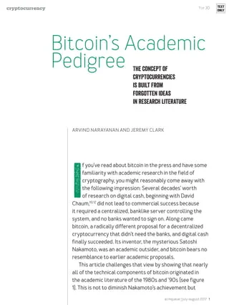
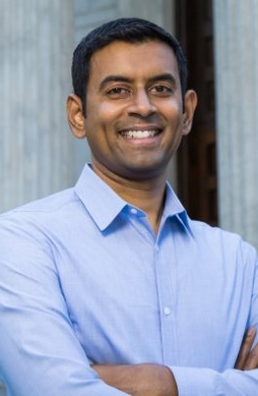
Arvind Narayanan
Arvind Narayanan is an assistant professor of computer science at Princeton. He leads the Princeton Web Transparency and Accountability Project to uncover how companies collect and use our personal information. Narayanan also leads a research team investigating the security, anonymity, and stability of cryptocurrencies, as well as novel applications of blockchains. He co-created a massive open online course, and a textbook on bitcoin and cryptocurrency technologies.

Slide 3
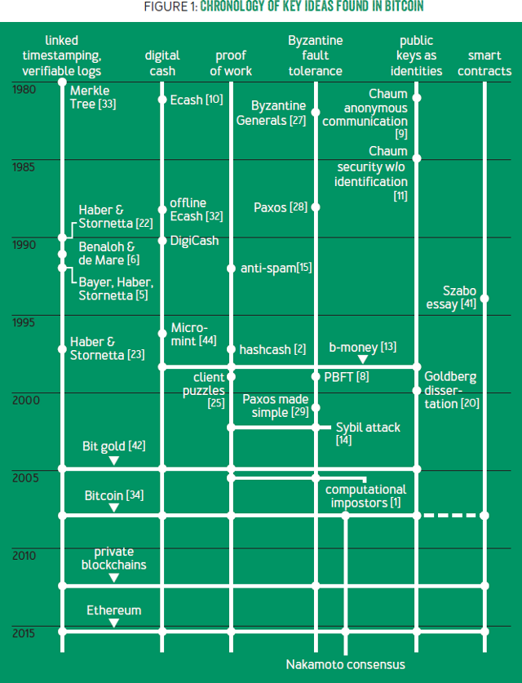
The concept of cryptocurrencies is built from forgotten ideas.
“Several decades' worth of research on digital cash, beginning with David Chaum, did not lead to commercial success because it required a centralized, banklike server controlling the system, and no banks wanted to sign on.”
<Bitcoin's Academic Pedigree> challenges that view by showing that nearly all of the technical components of bitcoin originated in the academic literature of the 1980s and '90s (see figure right). This is not to diminish Nakamoto's achievement but to point out that he stood on the shoulders of giants. Indeed, by tracing the origins of the ideas in bitcoin, we can zero in on Nakamoto's true leap of insight—the specific, complex way in which the underlying components are put together. This helps explain why bitcoin took so long to be invented.

Slide 4
The idea of a ledger is the starting point for understanding Bitcoin.
Ledger is a place to record all transactions that happen in the system, and it is open to and trusted by all system participants. Bitcoin converts this system for recording payments into a currency.
How to build a ledger? There are some properties to know about:
The ledger should be immutable or, more precisely, append-only.
Obtain a succinct cryptographic digest of the state of the ledger at any time.
The reason for these properties is that the ledger is a global data structure collectively maintained by a mutually untrusting set of participants. This contrasts with another approach to decentralizing digital ledgers, in which many participants maintain local ledgers and it is up to the user querying this set of ledgers to resolve any conflicts.

Slide 5
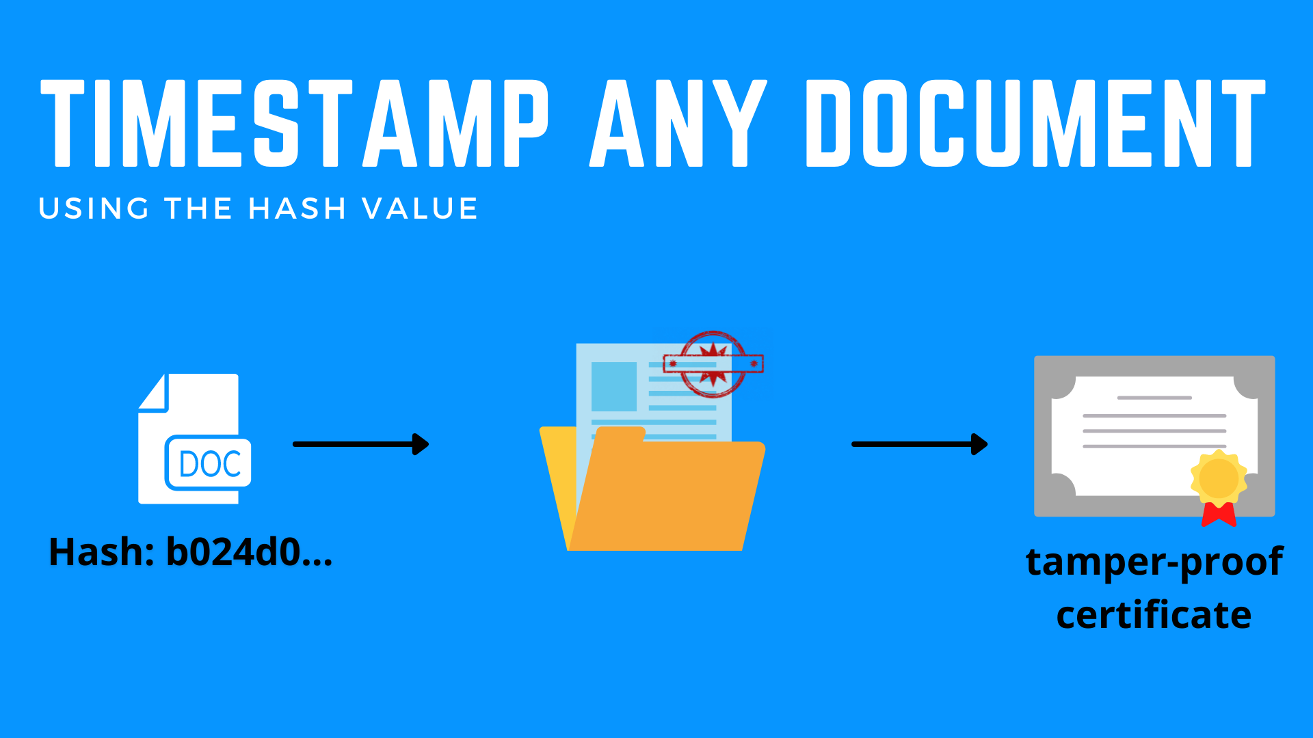
Linked timestamping
In a simplified version of Haber and Stornetta's proposal, documents are constantly being created and broadcast. The creator of each document asserts a time of creation and signs the document, its timestamp, and the previously broadcast document. This previous document has signed its own predecessor, so the documents form a long chain with pointers backwards in time. An outside user cannot alter a timestamped message since it is signed by the creator, and the creator cannot alter the message without also altering the entire chain of messages that follows. Thus, if you are given a single item in the chain by a trusted source, the entire chain up to that point is locked in, immutable, and temporally ordered.

Slide 6
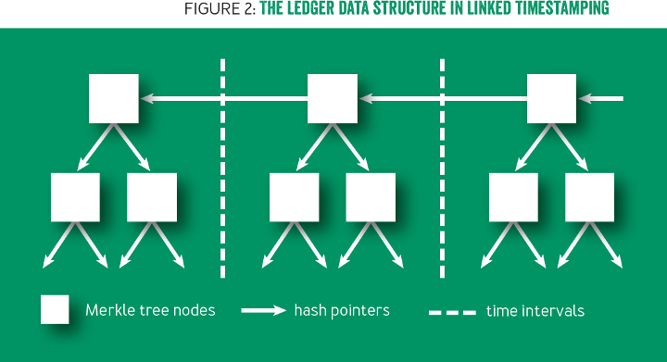
Merkle trees
Bitcoin uses essentially the data structure in Haber and Stornetta's 1991 and 1997 papers, shown in simplified form in figure 2. In each block's Merkle tree, the leaf nodes are transactions, and each internal node essentially consists of two pointers. This data structure has two important properties.
First, the hash of the latest block acts as a digest.
Thus, if you know the latest hash, you can download the rest of the ledger from an untrusted source and verify that it hasn't changed.

Slide 7
Byzantine fault tolerance & Proof of Work
A distributed ledger will inevitably have forks, which means that some nodes will think block A is the latest block, while other nodes will think it is block B. This could be because of an adversary trying to disrupt the ledger's operation or simply because of network latency, resulting in blocks occasionally being generated near-simultaneously by different nodes unaware of each other's blocks.
Virtually all fault-tolerant systems assume that a strict majority or supermajority (e.g., more than half or two-thirds) of nodes in the system are both honest and reliable. In an open peer-to-peer network, there is no registration of nodes, and they freely join and leave. Thus an adversary can create enough Sybils, or sockpuppet nodes, to overcome the consensus guarantees of the system. The Sybil attack was formalized in 2002 by John Douceur,14 who turned to a cryptographic construction called proof of work to mitigate it.

Slide 8
Putting it all together
Nakamoto's genius, then, wasn't any of the individual components of bitcoin, but rather the intricate way in which they fit together to breathe life into the system.
Bitcoin converts this transactions system for recording payments into a currency.
In bitcoin, a secure ledger is necessary to prevent double spending and thus ensure that the currency has value. A valuable currency is necessary to reward miners. In turn, strength of mining power is necessary to secure the ledger. Without it, an adversary could amass more than 50 percent of the global mining power and thereby be able to generate blocks faster than the rest of the network, double-spend transactions, and effectively rewrite history, overrunning the system. Thus, bitcoin is bootstrapped, with a circular dependence among these three components.

Slide 9
Conclusion
In general, the history described here offers rich and complementary lessons for practitioners and academics. Practitioners should be skeptical of claims of revolutionary technology.
As shown here, most of the ideas in Bitcoin that have generated excitement in the enterprise, such as distributed ledgers and Byzantine agreements, actually date back 20 years or more. Recognize that your problem may not require any breakthroughs—there may be long-forgotten solutions in research papers.

Slide 10


Feedback is welcomed.
https://github.com/kenlabs/Beginners-Guide-to-Filecoin

